Slide 1
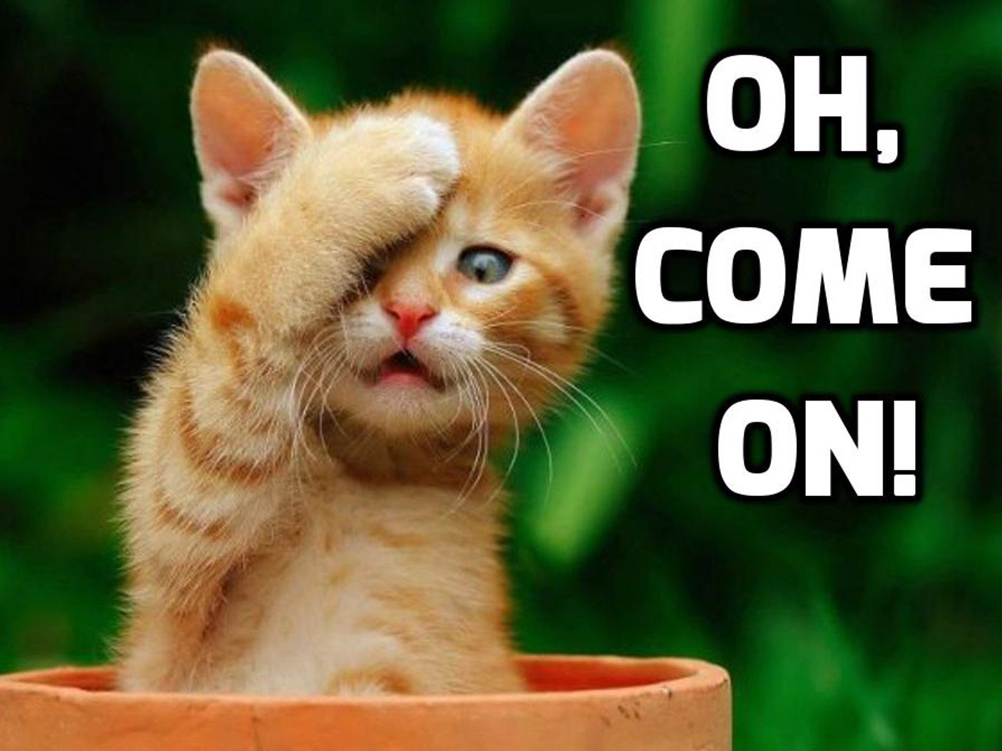
Understanding
animals

Slide 2
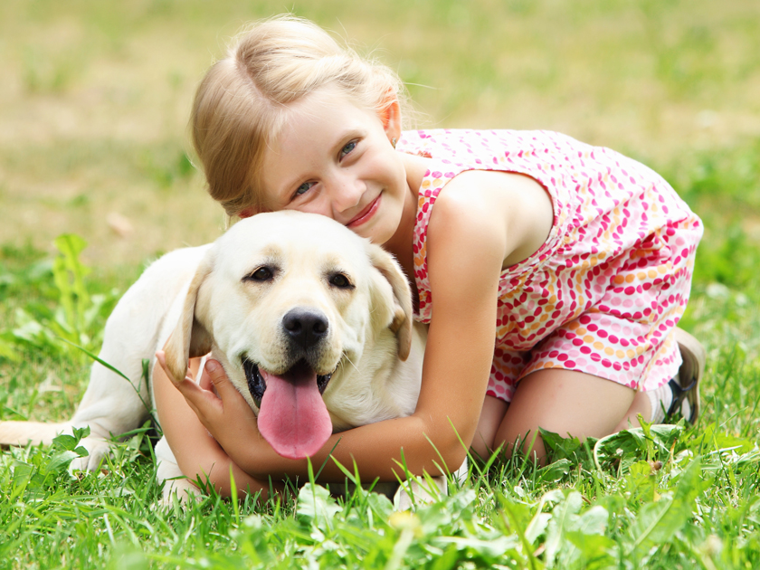
Animals & people

Slide 3
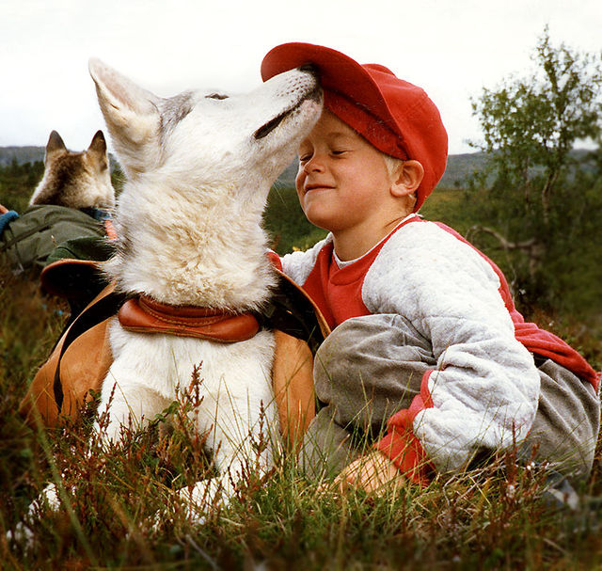
Relationship

Slide 4
First and most necessary, Human beings should truly respect animals in minds.

Slide 5
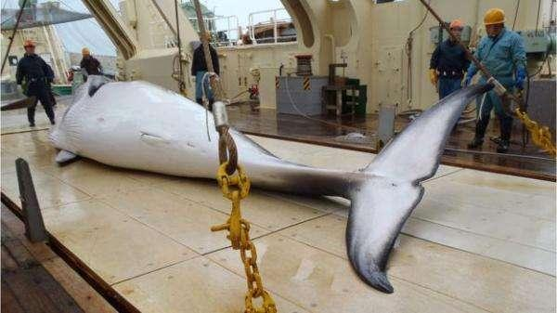
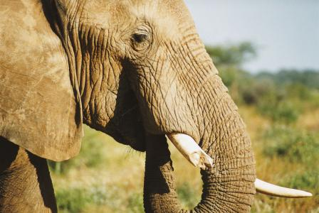
Eating meat is not equal to unrestrained access. Using the resource should be scientific. Don’t hunt animals cruelly for just funny and enjoying any more.

Slide 6
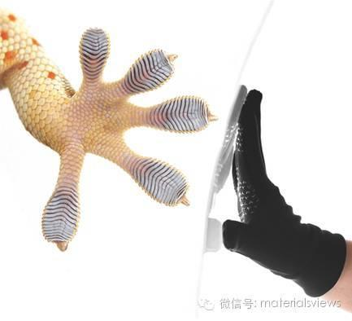
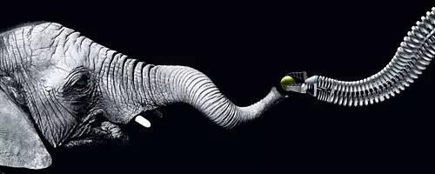
Human beings have learned a lot from animals, we should approval the wonderful power of nature and not be so arrogant.

Slide 7
What’s more, since we have gotten so much from animals, we should protect those animals endangered, protect the lands they live on.

Slide 8
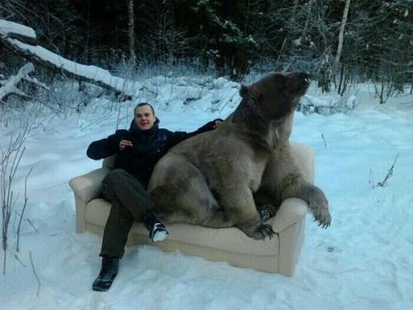
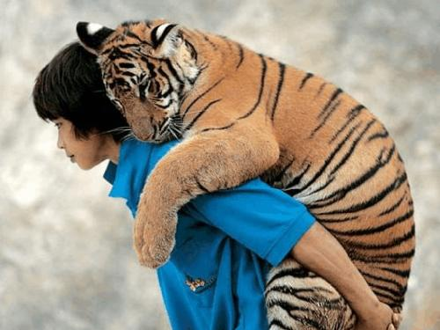
Animals are the best friends of human beings, without them, the earth is too monotonous and lonely.

Slide 9

Reality
Notes:
Well ,let know about some realities. The reality about the relationship between human beings and animals.

Slide 10
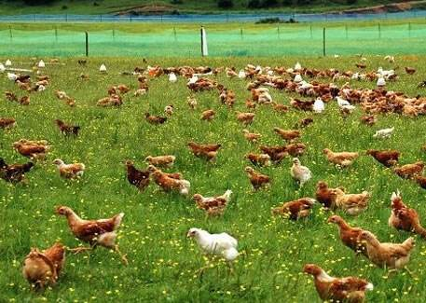
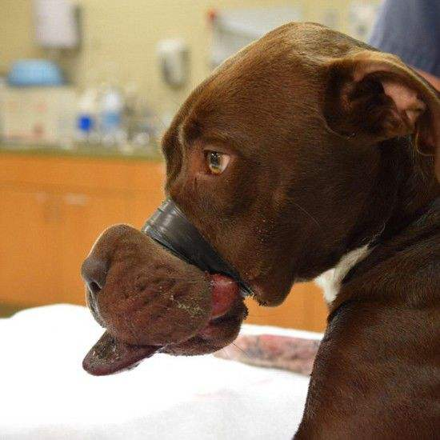
Public impression
Notes:
* One major opinion is that animals raised by human beings have rights like human beings and live a happy life.
* Like what displayed on television and printed on advertisement paper. They have big ‘play ground’ to play freely and eat delicious foods. Besides, they will accept physical examination and be treated timely. With reasonable and humanistic breeding they will keep in good health and have a positive mood.
*Another major opinion is that animals are suffering great pain and they totally have no rights or respect.
* We can also see on some video that many animal like pig will killed cruelly. Some pets like dogs were under maltreat of their owners. Some endangered animals were killed because of the drive of the of the profile.

Slide 11


Facts
Notes:
* As a matter of fact. Both of them exists. In some area, most animals are taken good care of even if some kind of animals like pigs. People will let them fell less pain when killing them. However, in other places, thing may not be so fantastic to animals. We have to admit that some of us kill animals just for unreasonable profile, vanity or just for fun. They killed animals in extremely cruel way. That's what most of us can't accept.

Slide 12

Present situation & future
Notes:
* We are happy to witness the found of all kinds of animal rights protection organizations and more and more volunteers participating various of activities. With the developing of human beings, animals rights were being more and more think highly of. We start to care about what animals feeling and whether they lives well.
* We are also sad to see news that there were still hundred of thousands of abandoned pet walking alone the street and have no place to sleep and no food to eat. Hundreds of thousands of endangered animals were being killed everyday illegal because it will bring income to hunters. Some children and adults get joy by cheating small and weak animals such as their home hold animals, Id don't think their home hold animals can be seen as pets, these animals are more like inanimate objects to their owner.
* Well we shoud be confident to our future ,and at the meantime, we have to suffering the pain to overcome the difficulty to improve our mind and thought.

Slide 13
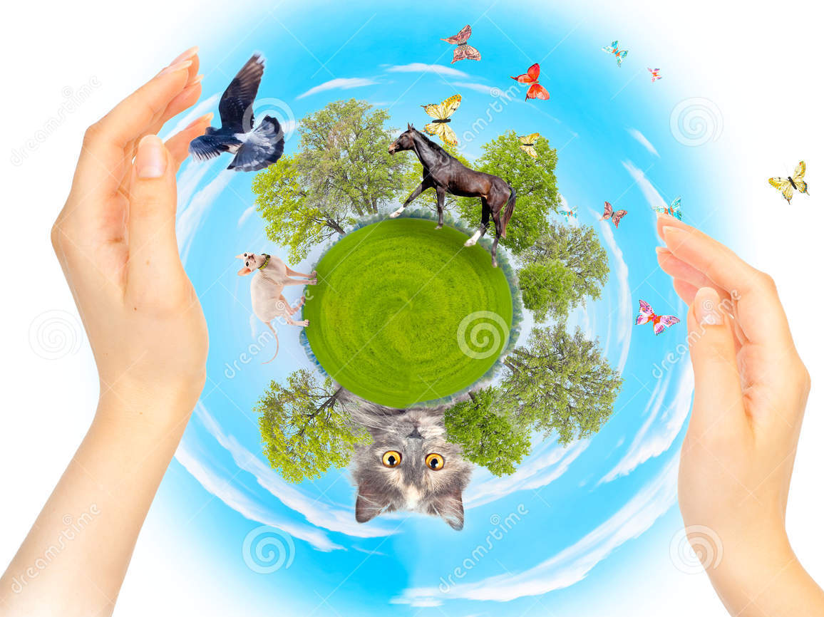
Humanity & ecology

Slide 14
Humanity
People for the Ethical Treatment of Animals

Slide 15
Catalogue
Brief Introduction
Positions
PETA Asia-Pacific

Slide 16
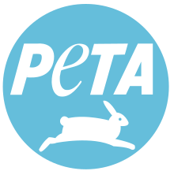
BRIEF INTRODUCTION
Founded | March 22, 1980; 38 years ago
Founder | Ingrid Newkirk Alex Pacheco
Type | 501(c)(3)
Focus | Animal rights
Location | Norfolk, Virginia, United States
Members | 6.5 million (including supporters)
Revenue | $43 million in 2014
Employees | 389
Website | www.peta.org
Notes:
People for the Ethical Treatment of Animals is an American animal rights organization based in Norfolk, Virginia, and led by Ingrid Newkirk, its international president. A nonprofit corporation with nearly 400 employees, it claims that it has 6.5 million members and supporters, in addition to claiming that it is the largest animal rights group in the world. Its slogan is "Animals are not ours to eat, wear, experiment on, use for entertainment, or abuse in any other way.

Slide 17
Positions
Direct action and the ALF
Neutering, backyard dogs, working animals and pets
Animal testing
Clothing
Autism and dairy products controversy
Wildlife conservation personalities

Slide 18
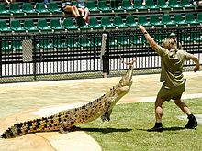
Wildlife conservation personalities
PETA argues that conservation personalities, such as Steve Irwin(pictured above), place animals under stress.
Notes:
PETA is critical of television personalities they call self-professed wildlife warriors, arguing that while a conservationist message is getting across, some of the actions are harmful to animals, such as invading animals' homes, netting them, subjecting them to stressful environments, and wrestling with them—often involving young animals the group says should be with their mothers.^{[175]} In 2006 when Steve Irwin died, PETA's vice-president Dan Mathews said Irwin had made a career out of antagonizing frightened wild animals.^{[174]} Australian Member of Parliament Bruce Scott said PETA should apologize to Irwin's family and the rest of Australia.^{[176]}

Slide 19
PETA Asia-pacific
Notes:
PETA Asia-Pacific was founded by Ingrid Newkirk in Hong Kong in 2005 to support animal rights programs and campaigns in Asia. Jason Baker, a former staff member of PETA who was involved in setting up PETA India and PETA Australia, is PETA Asia-Pacific's first director. Its offices are in Hong Kong and Manila. It works through public education, animal cruelty investigations, research, animal rescue, legislation, special events, celebrity involvement, and protest campaigns. Its campaigns cover countries including China, Japan, Malaysia, and South Korea.^{[177]}

Slide 20
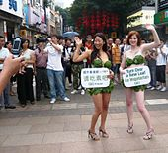
Vegetarian/vegan/factory farming
Lettuce Ladies in Guangzhou, China
Notes:
PETA Asia-Pacific promotes vegetarian and vegan diets through three specific campaigns: education about the benefits of a vegetarian diet,^{[178]} demonstrations and celebrity involvement against fast food outlets,^{[179]} and undercover investigations of animals used for live transport and traditional religious slaughter. The organization has also used the PETA Lettuce Ladies in local demonstrations.^{[180]} PETA Asia-Pacific regularly demonstrates against KFC outlets to promote better treatment of chickens used by the company.^{[181]}

Slide 21
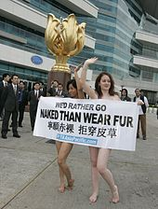
Anti-fur
PETA Asia-Pacific "naked" demo during Hong Kong fashion week
Notes:
PETA Asia-Pacific supports the PETA campaign "I'd Rather Go Naked Than Wear Fur," in which celebrities appear nude to express their opposition to wearing fur.^{[182]} The group also stages anti-fur events to publicize its opposition to fur.^{[183]} PETA Asia-Pacific has been involved in several undercover investigations of fur farms in China.^{[184]}

Slide 22
Ecology

Slide 23
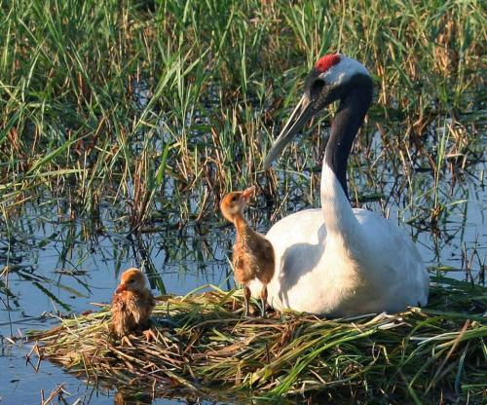
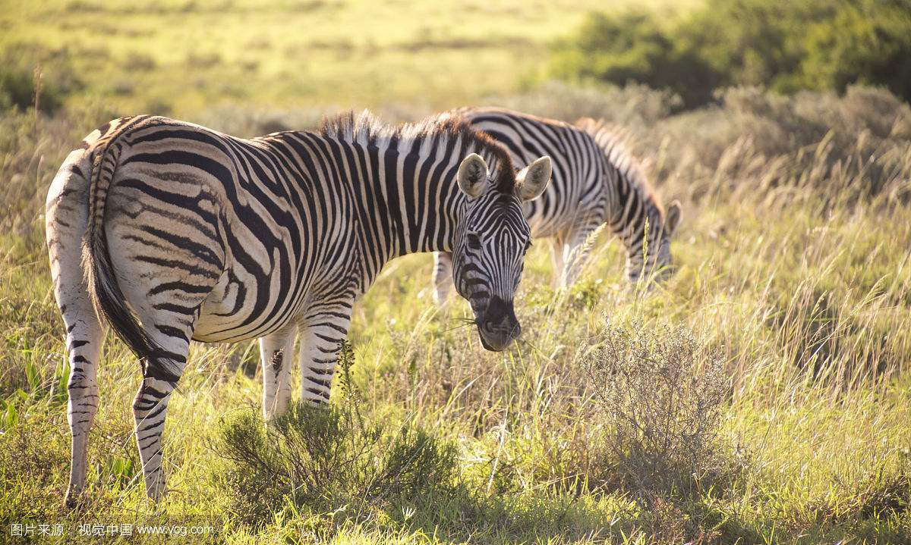
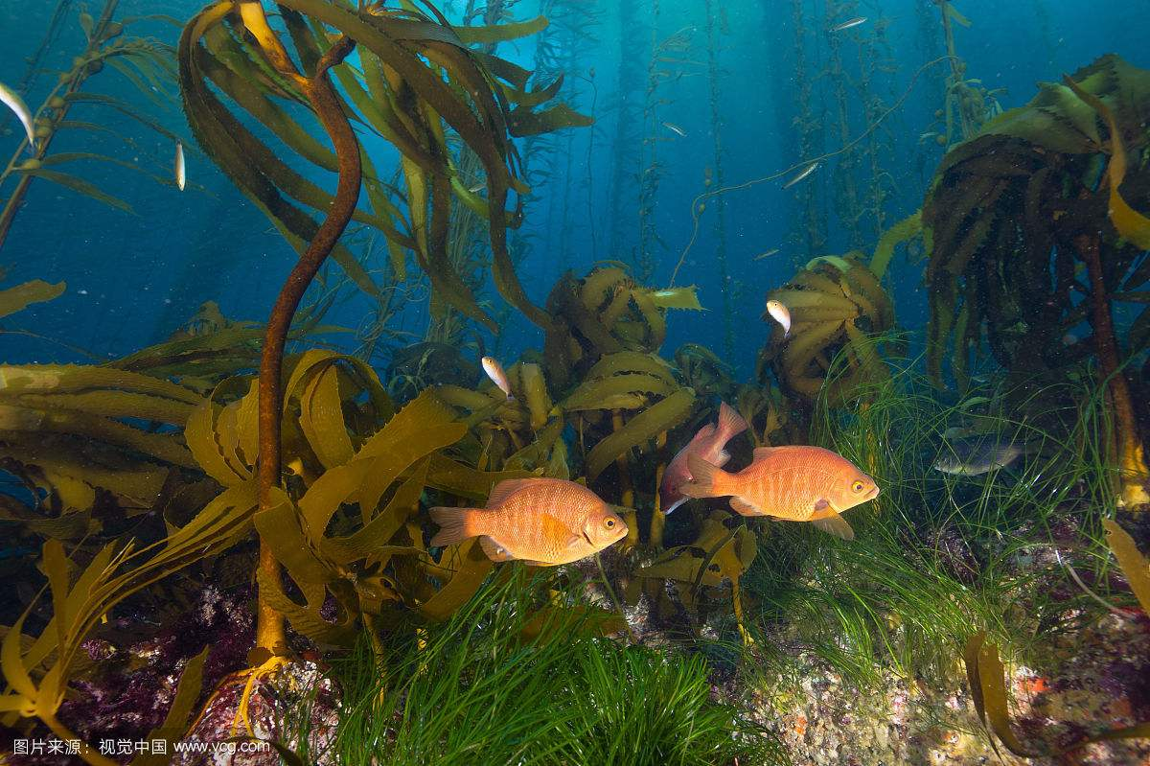
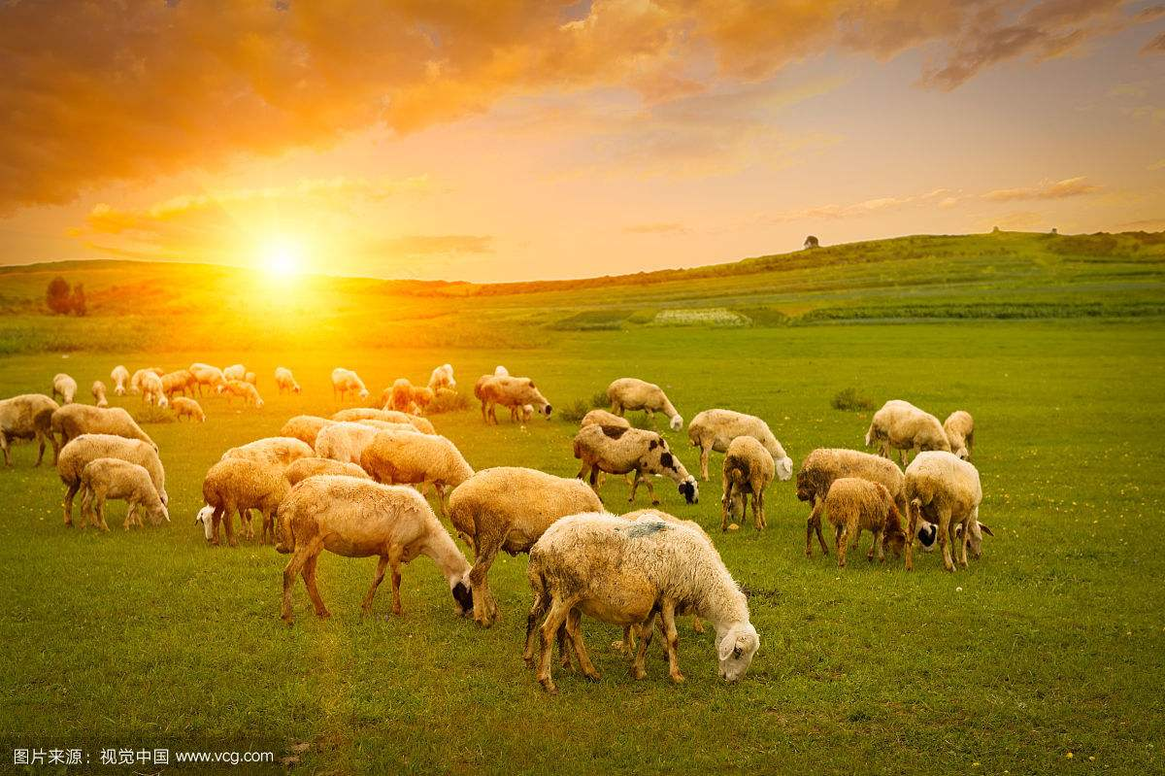
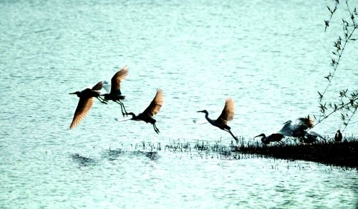
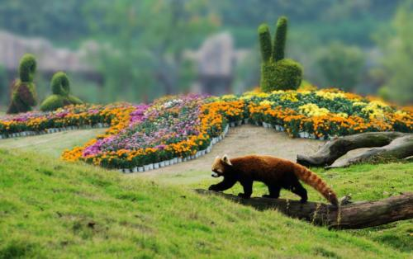
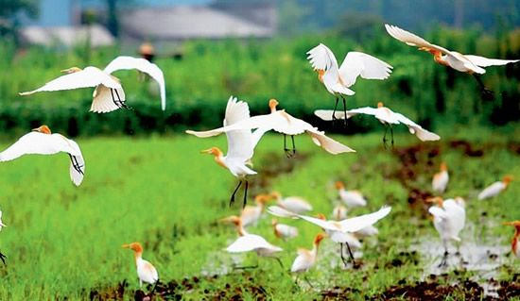
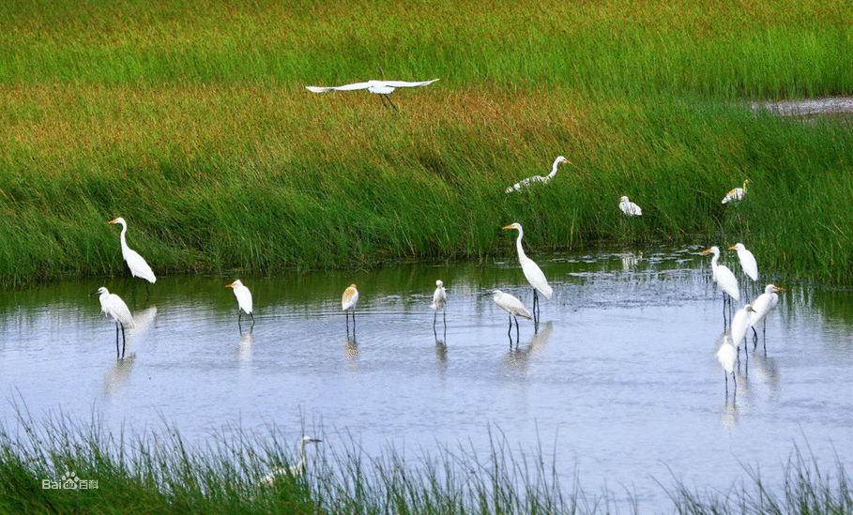
Notes:
Ecological equilibrium (ecological balance) refers to the state of high adaptation, coordination and unity between the organisms and the environment in a certain period of time and among the various species of organisms through energy flow, material circulation and information transmission.
As it's shown in these pictures,we can find that no matter an animal or a group of animals , nature is always more beautiful with the animals,
However, the animals who had lived comfortably lived in danger of extinction. In other words, that's to say, animals are the best partner of nature. Only with animals can the ecological environment become better and better, and nature becomes more and more beautiful.
As we all know , animals are the most important part of the ecology balance, which are called consumer in the food chain.And each kind of animals have different effect in ecology balance.For example,herbivores can keep the amount of plants, Carnivorous animal can keep the amount of herbivors.
But many people just don't understand the use of animals.They regard animals as goods, just for their own profit.Besides,lots of people don't
understand animals,they think animals have no emotions even the feel of pain.So they kill the animals as they wanted,which sometimes there is no meanings.
If the balance of ecology is broken, the next victim must be humans.So it's of great importance to understand animals and treat animals in a suitable way rather than just kill them to get money.Animals also have some human emotions, like mercy , pain , anger. I believe if we treat animals well , they will treat us well too and maybe save humans in the future.

Slide 24
Take action

Slide 25
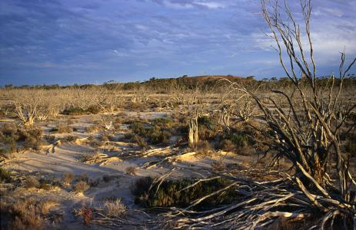
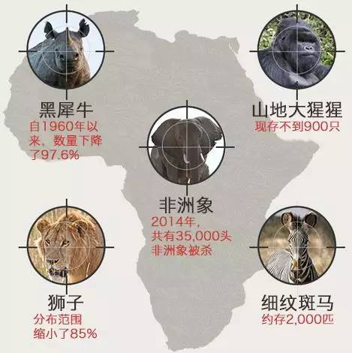
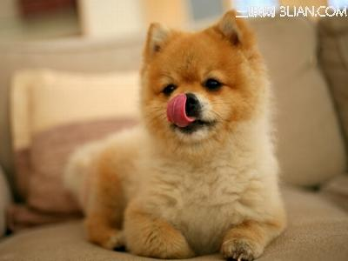
Humanitarianism activities
There are more and more endangered animals at present, so taking measures to protect animals is no longer an elective.
Raise people’s awareness of protecting animals, increasing the population of education for animal protection.
We have to prevent the environment from getting worse.
Stop killing the rare animals by perfecting relevant laws and taking some strict legal measures.
Notes:
In conclusion, there are more and more animals in danger at present, so protecting them has been our task of top priority.
First, most of people don’t realize the importance of animals, but in some ways, they are more important than we think. For example, animals play a significant role in maintaining the balance of nature. In the matter of fact. not animals need us, but we need them. Without animals, we can hardly survive and develop. In a world, we are equal to animals. So we must raise people’s awareness of protecting animals by the way of education.
Second, environment has been worse at a rapid rate. If we destroy the nature and take no actions in the face of environment’s getting worse, more and more species habitats will disappear, and then animals will die out. Thus we have to prevent the environment from getting worse.
Last, a great number of people kill rare animals for money regardless of their survival, especially the youngers. Many poachers become crazy about killing wild animals just for their fur, leather and bones. More than 30,000 African elephants are killed for ivory each year. So calling on these people to stop killing animals is an essential way, and if necessary, we must take some legal actions.

Slide 26
Thanks

